Slide 1
Sync Adapters
Ben Oberkfell NYC Android Meetup, 2/9/2016

Slide 2
Intro
I’m a software engineer at American Express, working on the US Cardmember servicing app for Android. GDG St. Louis Co-Organizer.
Twitter: @benlikestocode
G+: +BenOberkfell
BTW, we’re hiring: ben.oberkfell@aexp.com

Slide 3
Think of Your User
People use phone apps “in the moment.” Loading spinners suck.
People use phones in places with bad data coverage, and still expect value from their apps.
Probably most importantly, people expect their phones to have good battery life.

Slide 4
Sync Adapters: The Awesome
Introduced in API 5 (2.0)
Provide a designated place for the operating system to call your sync logic in the background.
Android can run them automatically upon Content Provider changes
Android can run your syncs periodically, and align with other network activity to be efficient on battery
Android can manage sync failures and automatically handle exponential back-offs
You can also run them on demand (based on your UI, or on an inbound GCM push)

Slide 5
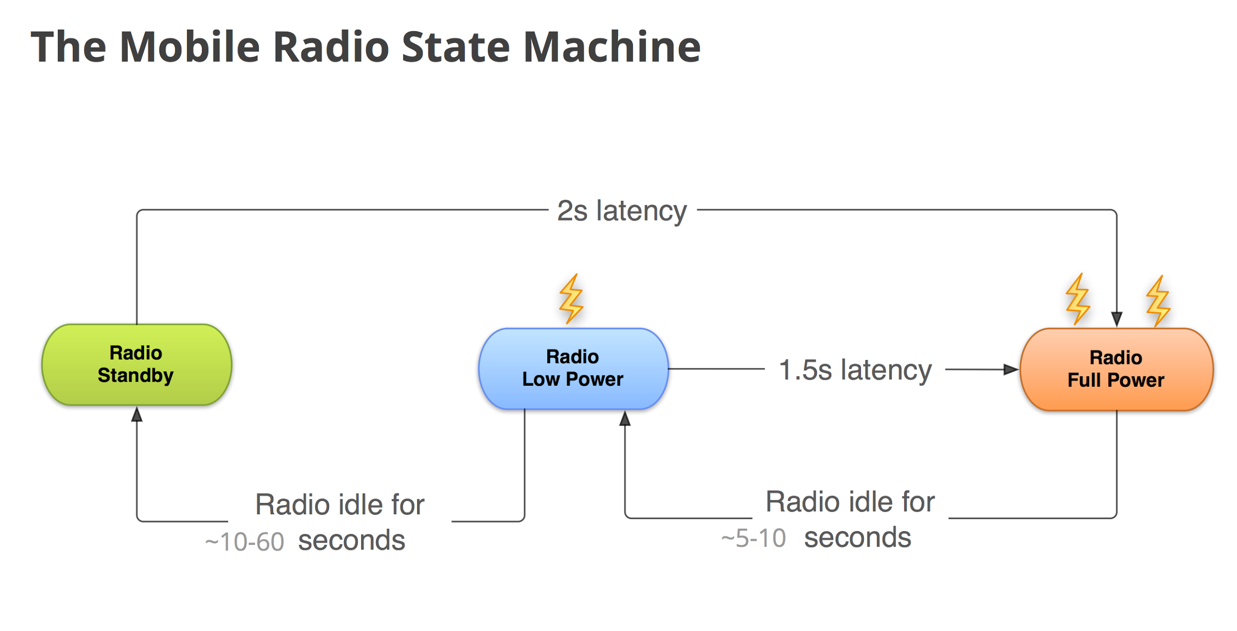
Let’s Talk Battery Life Real Quick
Source: Google I/O 2012, “Making Good Apps Great”

Slide 6
Sync Adapters: The Not So Awesome
Setting them up looks daunting, because the framework requires Account, an AccountAuthenticator, and a ContentProvider
But you don’t actually need to use them.
You don’t have to store your credentials in the Account. And unless you’re planning on sharing those credentials with other apps, it’s probably not worth the trouble.
You don’t have to use the ContentProvider for content. For instance, this presentation’s example uses Realm. If you’re not going to share your content outside your app, similarly, probably not worth the effort.
There’s no shame in stubbing these out, and just using the SyncAdapter to do your work.

Slide 7
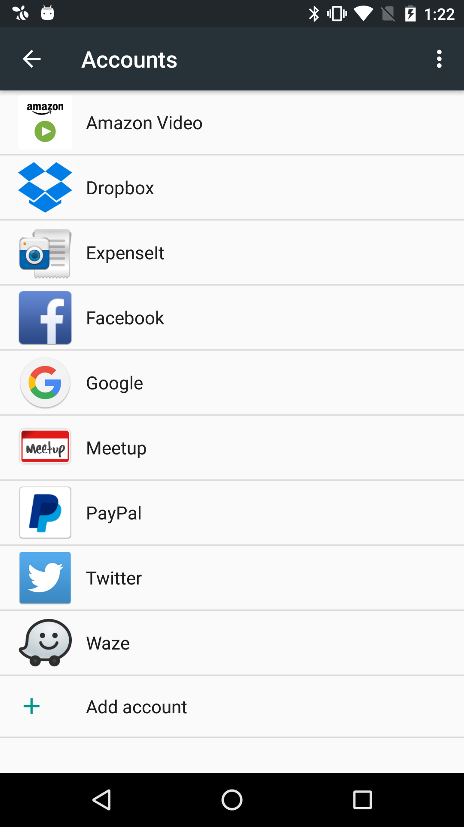

What’s an Account?
You might remember this from your Settings screen

Slide 8
In the Manifest
<service
android:exported="false"
android:name=".sync.DemoAuthenticatorService">
<intent-filter>
<action android:name="android.accounts.AccountAuthenticator"/>
</intent-filter>
<meta-data
android:name="android.accounts.AccountAuthenticator"
android:resource="@xml/authenticator" />
</service>
The resource file
<?xml version="1.0" encoding="utf-8"?>
<account-authenticator
xmlns:android="http://schemas.android.com/apk/res/android"
android:accountType="syncdemo.example.com"
android:icon="@mipmap/ic_launcher"
android:smallIcon="@mipmap/ic_launcher"
android:label="@string/app_name"/>
Defining the Account type and Authenticator

Slide 9
What’s a ContentProvider?
Provides a structured way to perform CRUD operations against data, and allows that to be shared across apps
A ContentProvider has an “authority,” which is a key that defines the provider
e.g. “com.example.socialfeed.posts” might be a ContentProvider that has your app’s social posts.
<provider
android:name=".sync.DemoContentProvider"
android:authorities="com.example.syncdemo.provider"
android:exported="false"
android:syncable="true"/>

Slide 10
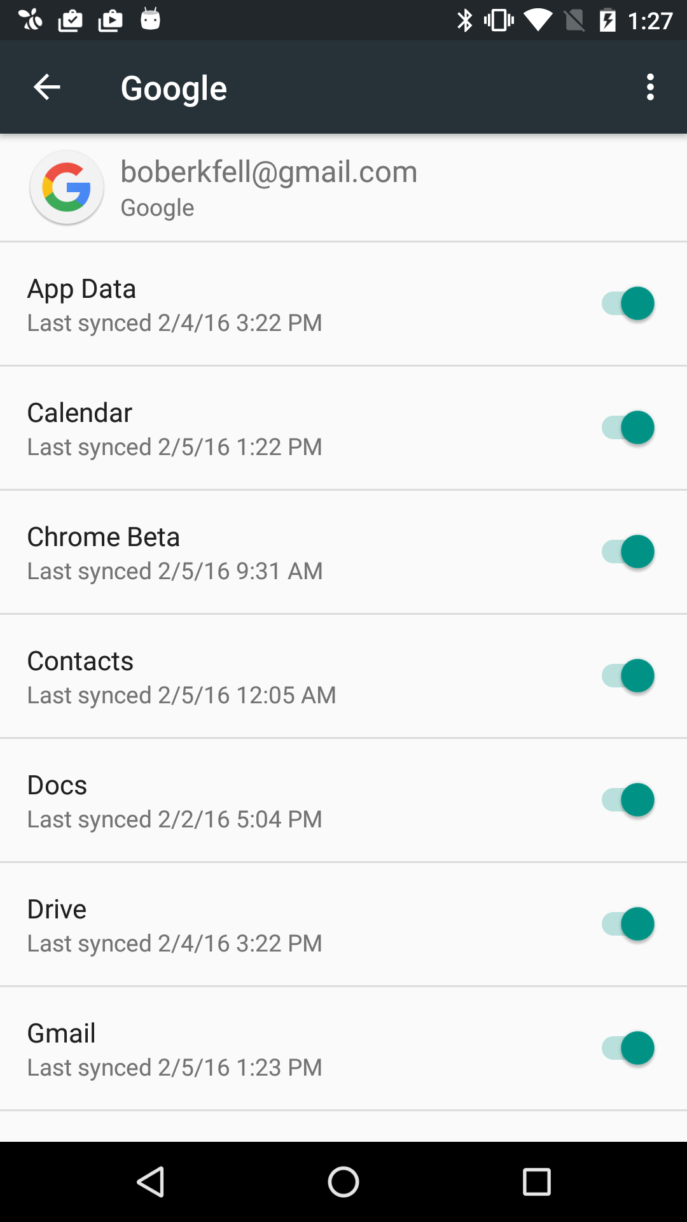
How does a SyncAdapter know what to sync?
A SyncAdapter syncs a ContentProvider for a given account.
For instance, your Google account has lots of content providers.

Slide 11
<service
android:name=".sync.DemoSyncService"
android:exported="true">
<intent-filter>
<action android:name="android.content.SyncAdapter"/>
</intent-filter>
<meta-data android:name="android.content.SyncAdapter"
android:resource="@xml/syncadapter" />
</service>
In the manifest
The resource file
<?xml version="1.0" encoding="utf-8"?>
<sync-adapter xmlns:android="http://schemas.android.com/apk/res/android"
android:contentAuthority="com.example.syncdemo.provider"
android:accountType="syncdemo.example.com"
android:userVisible="false"
android:supportsUploading="false"
android:allowParallelSyncs="false"
android:isAlwaysSyncable="true"
/>
Defining the Sync Adapter

Slide 12
How does a SyncAdapter do its work?
A SyncAdapter runs in a Service context.
You implement the onPerformSync method, which runs in its own thread. You get this for free.
Everything in this method has to run synchronously -- don’t make async calls here.
onPerformSync is passed a SyncResult reference, which allows you to indicate error conditions that inform whether to backoff and retry, or just give up.

Slide 13
Requesting Syncs
Automatic Syncing
Or, request a sync ASAP:
ContentResolver.setSyncAutomatically(account, AUTHORITY, true);
ContentResolver.addPeriodicSync(account, AUTHORITY, Bundle.EMPTY, 30 * 60);
private void fireSync() {
Bundle syncSettingsBundle = new Bundle();
syncSettingsBundle.putBoolean(ContentResolver.SYNC_EXTRAS_MANUAL, true);
syncSettingsBundle.putBoolean(ContentResolver.SYNC_EXTRAS_EXPEDITED,true);
ContentResolver.requestSync(account, AUTHORITY, syncSettingsBundle);
}

Slide 14
@Override
public void onPerformSync(Account account,
Bundle extras,
String authority,
ContentProviderClient provider,
SyncResult syncResult) {
MessagesSyncer syncer =new MessagesSyncer(Injector.provideRealm(getContext()),
prefsHelper, messageService);
MessageSyncResult result = syncer.performSync();
// Apply the potential soft errors from our result to the sync
syncResult.stats.numIoExceptions += result.numIoExceptions;
}
Doing the Sync

Slide 15
@Test public void testFailureSetsIoException() { Retrofit retrofit = Injector.provideRetrofit(DemoConstants.BASE_URL); NetworkBehavior networkBehavior = NetworkBehavior.create(); networkBehavior.setFailurePercent(100); networkBehavior.setFailureException(new IOException()); MockRetrofit mockRetrofit = new MockRetrofit.Builder(retrofit) .networkBehavior(networkBehavior) .build(); MessageService service = mockRetrofit.create(MessageService.class).returningResponse(null); MessagesSyncer syncer = new MessagesSyncer(mockedRealm, mockedPrefsHelper, service); MessageSyncResult result = syncer.performSync(); assertEquals(result.numIoExceptions, 1); }
Unit Testing Sync Logic Example

Slide 16
Error Handling
Use the SyncResult passed into onPerformSync to inform the OS of error conditions.
There are hard and soft error types
Soft Errors
For network IO exceptions for example - a situation where you could retry and maybe succeed
The sync framework will retry later, with an exponential backoff
Hard Errors
For data integrity issues, etc
The sync framework won’t try to retry
Check out the docs on d.android.com for SyncResult for more info

Slide 17
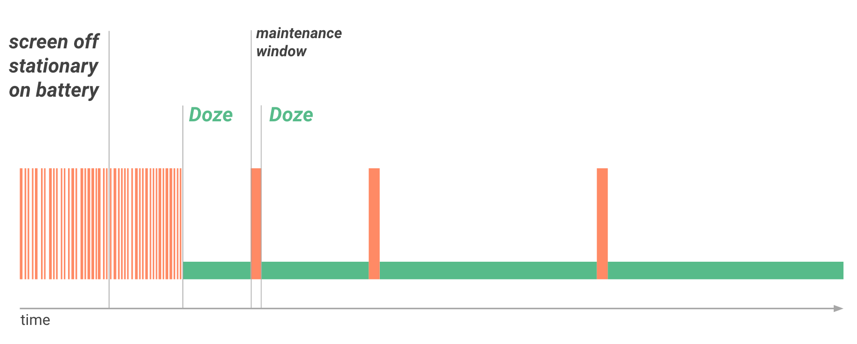
Marshmallow Doze Mode
In Doze, sync adapters do not run on a usual schedule
Periodically, your device will wake from Doze and fire any pending syncs
If you want to force a sync, you’ll need to send a high priority GCM that triggers a manual sync.
Source: developers.android.com

Slide 18
The Code
https://github.com/benoberkfell/sync-adapter-demo
Includes an example of how to use unit tests for your sync adapter logic.

